Slide 1
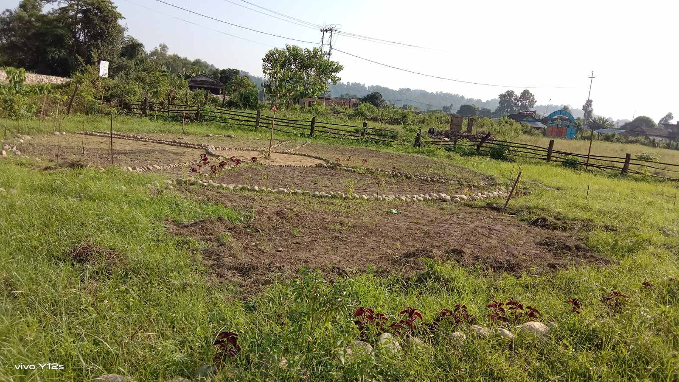
Cursory Photo Story of Green Activities in Schools
Greening+ in Janjyoti Basic Shool, Hakpara, Sindhuli in 2022

Slide 2
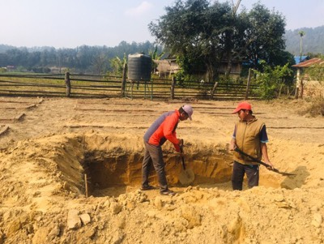
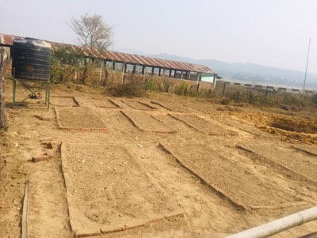
Preparing the land

Slide 3
Fencing a part

Slide 4
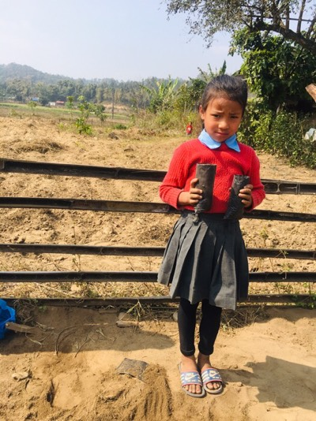
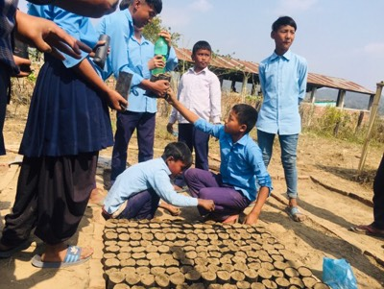
Sowing with students

Slide 5
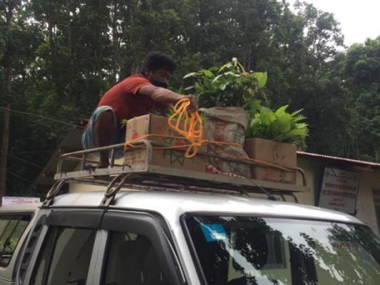
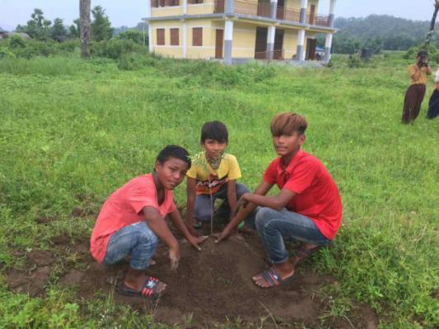
Acquiring some plants from other sources to give a momentum

Slide 6
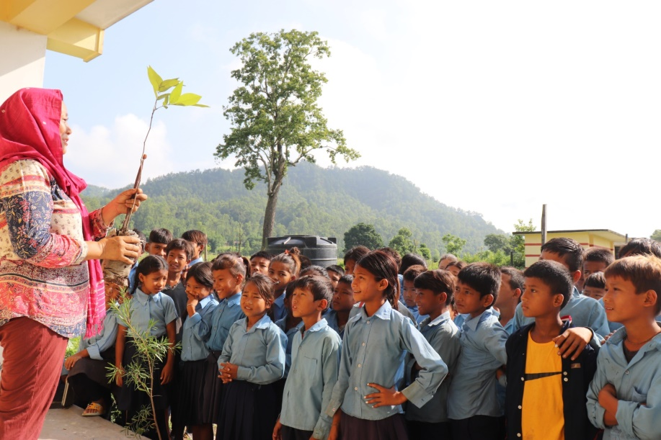
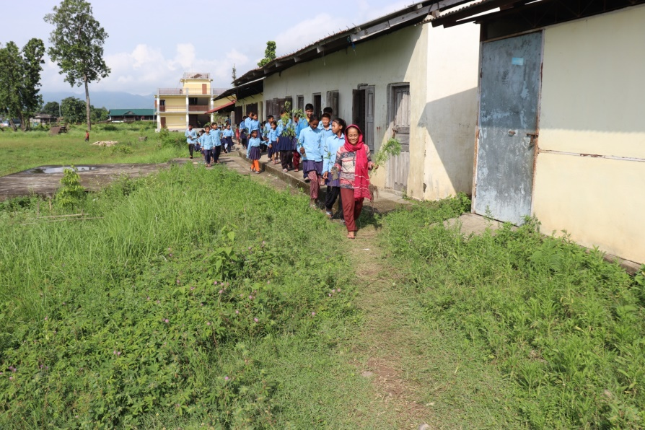
Talking about planting and plants: what and why

Slide 7
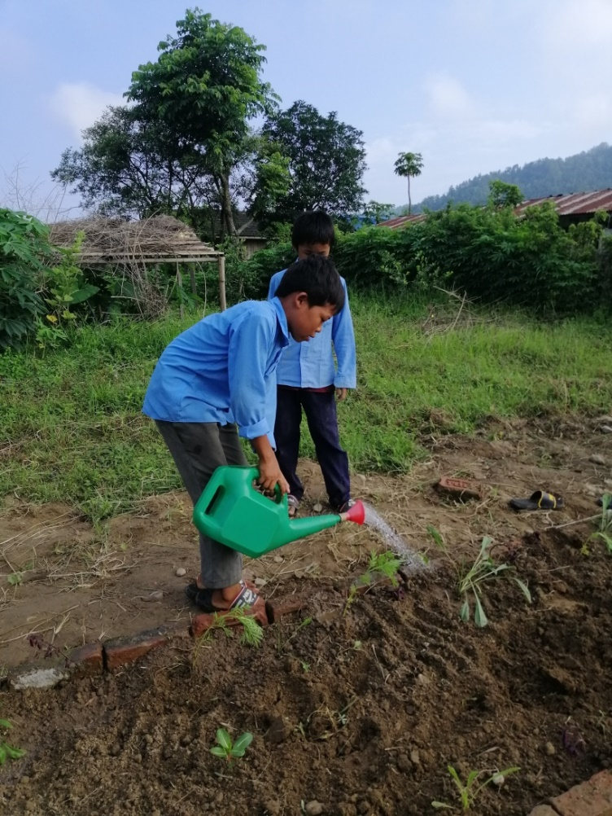
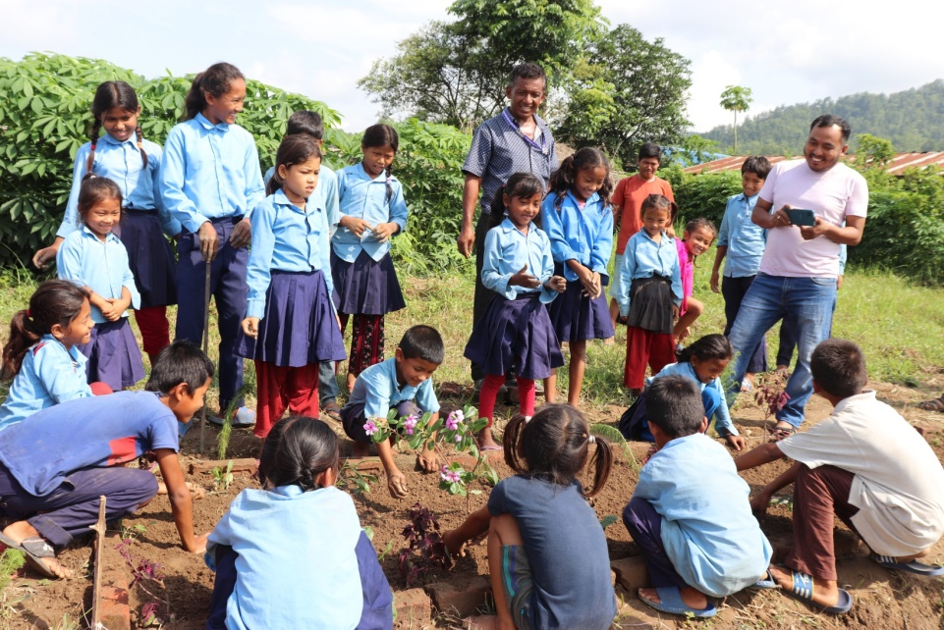
Getting students involved relating their lessons

Slide 9
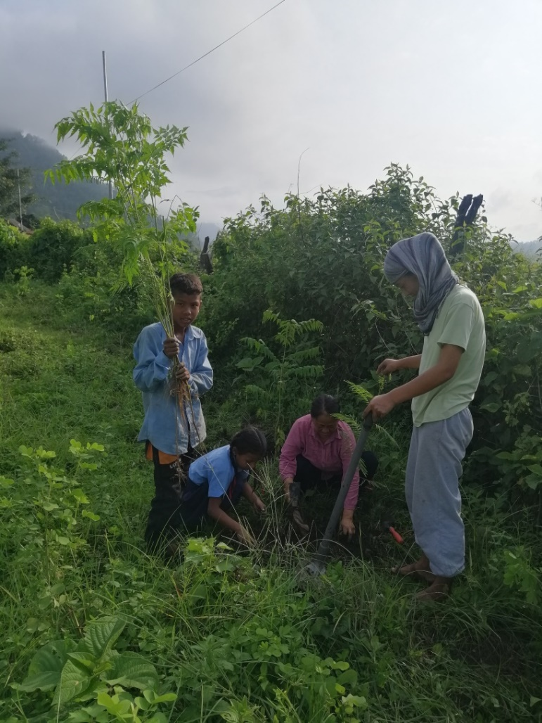
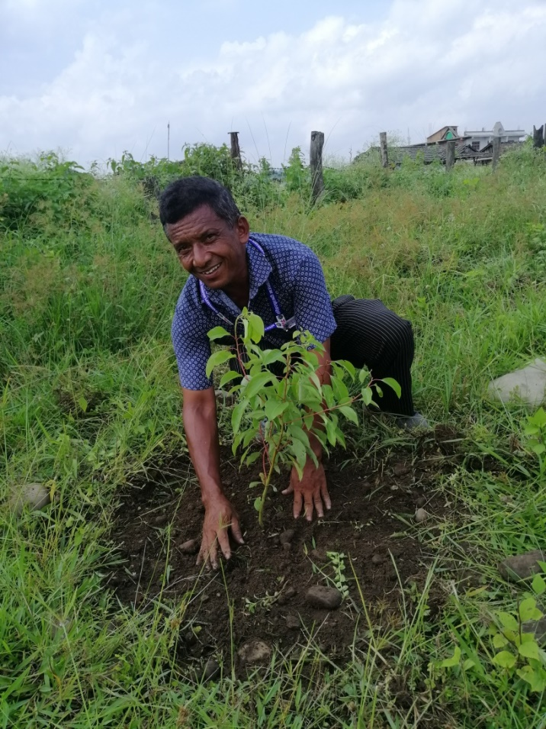
Getting students and teachers together for plantations

Slide 10
Parents join for plantations and also take plants home from the nursery

Slide 11
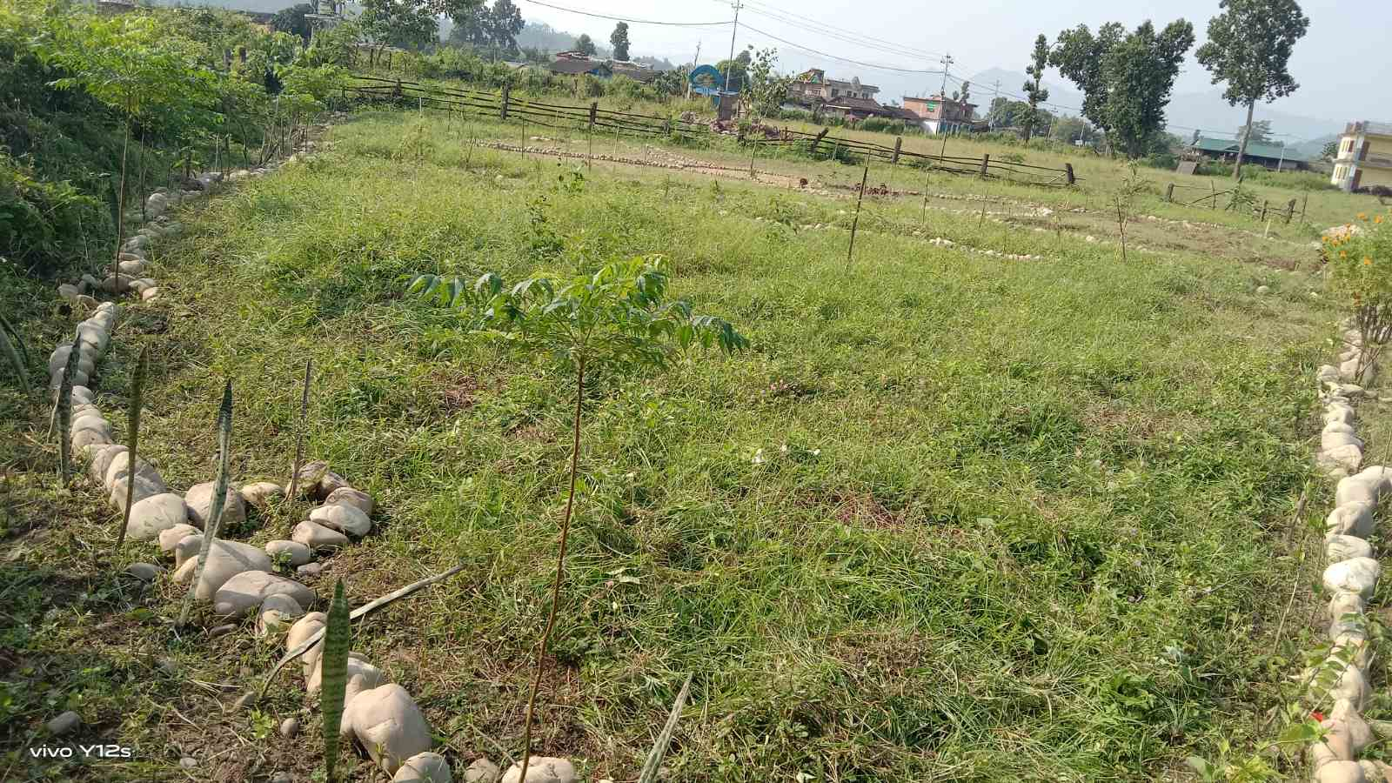
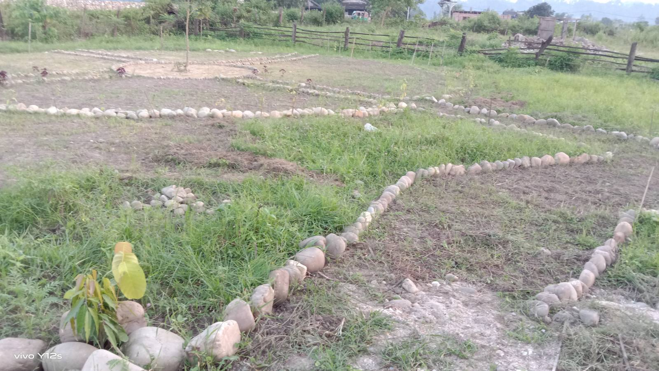
Laying out a garden with students

Slide 12
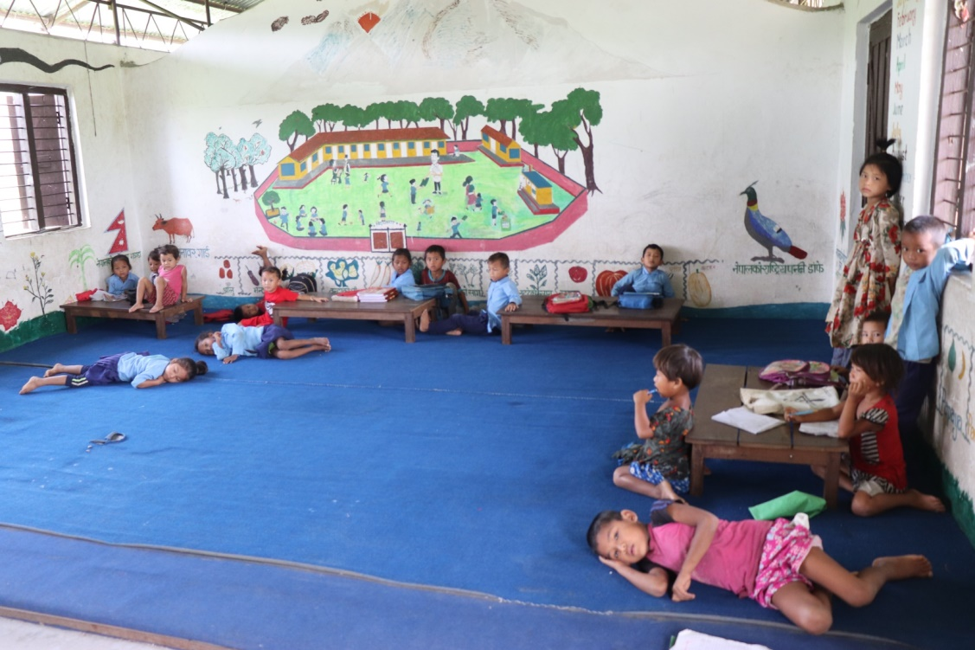
Taking other measures to make classes more interesting for children.

Slide 13
Thanks for the support!

